Slide 1

Master-Invoice
Built to bill, inevitable.
Presented by : Team while(1)

Slide 2



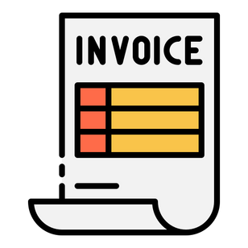


Introduction
Master
Invoice
Inventory
Management
Invoice
Generation
Transactions
Analysis

Slide 3
Introduction
Master
Invoice
Inventory
Management
Invoice
Generation
Transactions
Analysis

Slide 4


Need for the Software
Master
Invoice
Manual inventory tracking is time-consuming and error-prone
Many businesses rely on physical registers to track stock, prices, seller and buyer details and quantities, often leading to mismatches, missed updates, or stockouts.
To streamline operations
by automating inventory billing and transactions tracking
No centralized record of retailers, suppliers, and transaction history
Most businesses lack a single platform to view past transactions, dues, and contact details for each stakeholder, leading to confusion and poor tracking.
Lack of insight into profit trends and product-wise sales
Businesses often don’t analyze their sales trends due to lack of tools or time, missing key insights like seasonal demands or best-selling items.

Slide 5





Potential Users
Master
Invoice
Wholesalers
Distributors
Enterprises
Super Stockists
B2B Traders
Chain Distributors

Slide 6


Major Requirements
Master
Invoice
Inventory
Manage inventory allows the user to view all the current products available in user’s inventory and their details like Item ID, Cost Price, Selling Price, MRP, GST (%) and Quantity.
The details of existing products are editable and new products can be added.
The Selling Price, Quantity and GST % are extracted from the Inventory app during the addition of invoices.
Inward and Outward Supply
Stores the editable details of retailers and suppliers registered along with their invoice histories.
Allows user to add invoice with the retailer/supplier, bill number, date, list of product-quantity pairs and discount % (incase of retailer invoice bill)
During the addition of the bill, total amount for the bill is calculated dynamically. This amount is added to the pending transactions for the particular retailer/supplier and the quantity for each product is updated in the inventory.

Slide 7


Major Requirements
Master
Invoice
Transactions
Add Inward Transactions:
Record incoming monetary value from retailers, including date and cost.
Add Outward Transactions:
Record incoming monetary value to suppliers, including date and cost.
Transaction History:
View a chronological log of all transactions with filtering options based on date ranges for easier tracking.
Pending:
Displays current outstanding balances, showing net debt for both suppliers and retailers in a consolidated view.
Analysis
Display profits and sales over time based on user-defined periods with basic statistics
Present graphs for:
Bills generated (last 2 months)
Inward transactions (last 2 months)
Present tables showing sales per product for:
1-month period
3-month period
6-month period

Slide 8

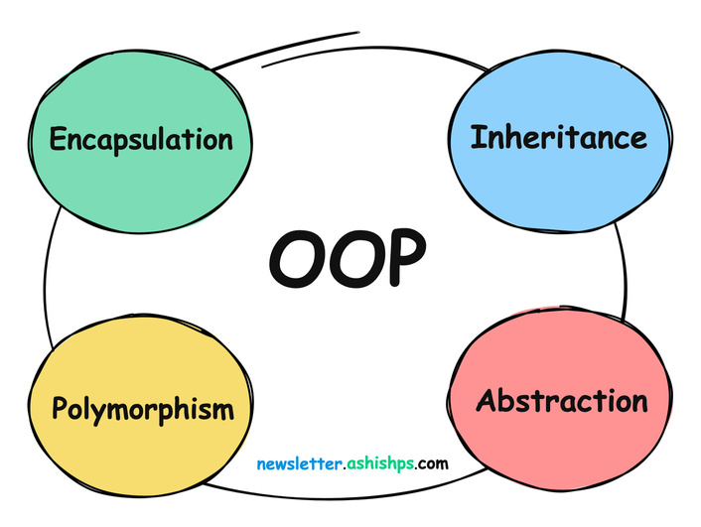
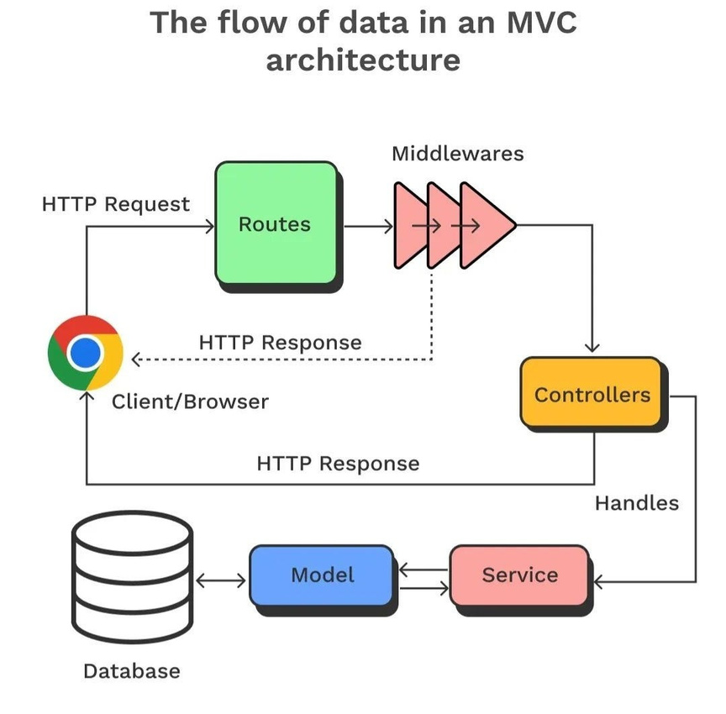
Design
Master
Invoice
Model View Architecture
Multiple views for common data access
Object Oriented Design
Encapsulated, modular, and reusable classes
Page-wise Views and Controllers
Separate logic for each feature page

Slide 9






Implementation
Master
Invoice
🖥 Frontend :
Built using HTML, CSS, and JavaScript for a responsive and interactive user interface.
⚙️ Backend :
Developed with Django (Python), following OOP-inspired modular architecture for maintainable and scalable server-side logic.
📜 Database :
Utilizes SQLite3, a lightweight and fast database, ideal for local development and testing.
📈 Graphs & Visualization :
Integrated Chart.js to show data through dynamic charts and graphs.
🪪 Authentication :
Secure authentication via Google SMTP, used for email-based verification and notifications (e.g., OTP systems).

Slide 10
WEBSITE
Master
Invoice
https://master-invoice.onrender.com/
LINK

Slide 11

Future Implementations
Master
Invoice
ML BASED RECOMMENDATION SYSTEMS FOR PRODUCT ANALYSIS
CLOUD BASED DATABASE SYSTEM,
WAY BILL AND MORE ENHANCED FORMAT OF BILL
PDF AND EMAIL GENERATION FOR BILLS TO THE RETAILERS
SORT FILTERS IN VIEW INVENTORY, SUPPLIERS, TRANSACTIONS AND IMPROVED TAX SYSTEM

Slide 12

Master
Invoice
Learnings...
Operational :
Time and Resource Management
Team Collaboration
Plan-driven Process
Decision Making
Accountability & Responsibility
Technical :
Frontend
Authentication
Testing
Version Control (Git, GitHub)
Backend Development
Database Handling
Deployment

Slide 13










Master
Invoice
TEAM
Kundan
Kethan
Koushik
Sai Saketh
Umesh
Srijani
Obul
Praneeth
Kishore
Cezan

Slide 14





Master
Invoice
Thank You

